Slide 1

PWW Presentation
How to Place an Online Order

Slide 2
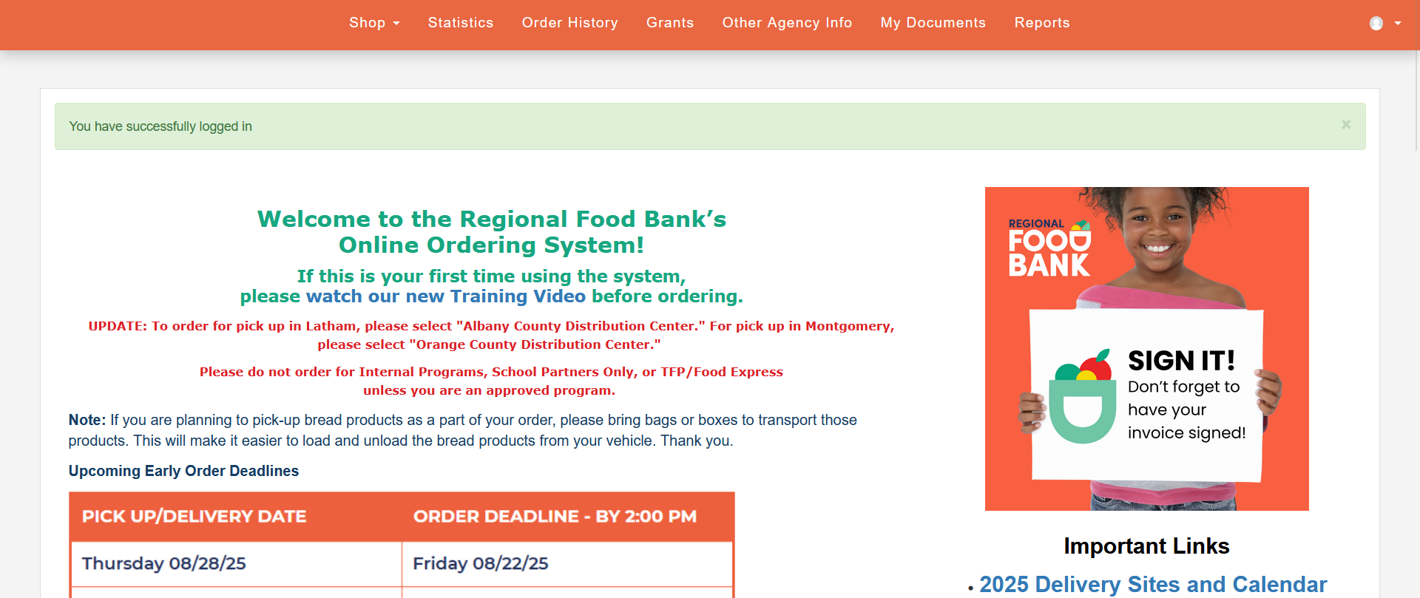
What is PWW?
It’s an internal website that allows your agency to bulk order approved foods and schedule them for pick-up or delivery. The website provides several features such as:
Access to the Regional Food Bank’s live inventory
The ability to submit monthly HPNAP reports
View your agency’s individual grant balances
View invoices, statements, and previous orders placed at the Regional Food Bank
Access to early order deadline reminders

Slide 3
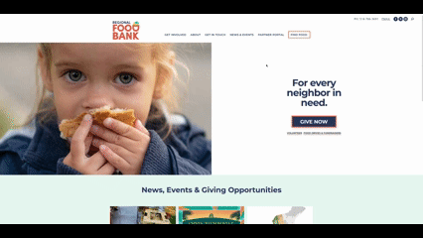
How to Access PWW
Head over to www.regionalfoodbank.net
Click on “Partner Portal” on the top menu
Click on “Online Ordering”
Fill in the login information
  Agency Reference: Your Agency ID
  Username: Your Agency ID
  Password: This was assigned to you by the Regional Food Bank. Please note: The password is case sensitive
  Contact membersvcs@regionalfoodbank.net if you have login issues

Slide 4
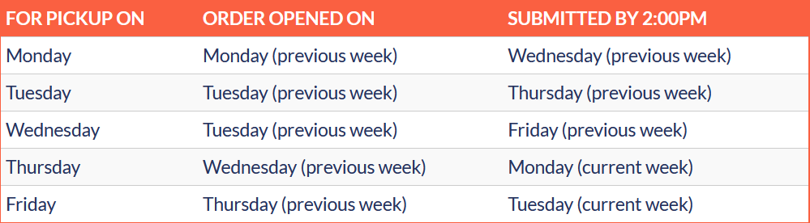
Ordering Guidelines
It’s important to be aware of the ordering guidelines and upcoming closures that will affect order deadlines.
Orders open 6 business days before the pickup/delivery date and are due 3 business days before the pickup/delivery date. Orders are always due at 2:00 PM.
Whenever our warehouse is closed for a holiday or inventory day, there will be early order deadlines surrounding that date.
Early deadline information is sent out via email each month and posted on the online ordering home page.
Our delivery schedule and delivery locations are located on the partner portal home page.

Slide 5
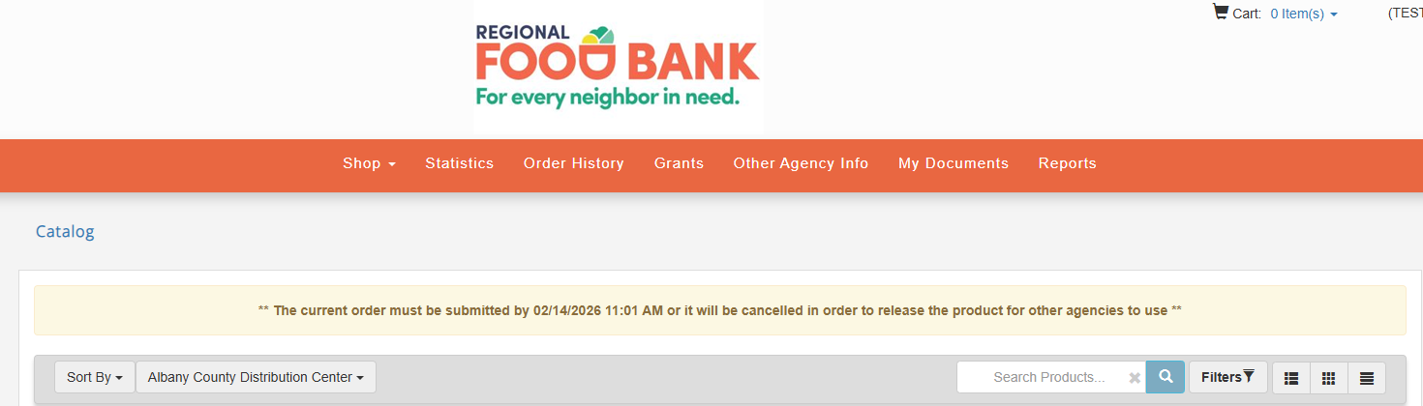
72-Hour Inventory Hold
Once you start an order, your items and time slot will be held for 72 hours. If you do not submit the order within 72 hours, the order will automatically be deactivated, and you will have to start a new order.
Once you have submitted your order, you can still add or remove items up until the regular order deadline by reaching out to the orders team (518) 786-3691 x3000 or orders@regionalfoodbank.net.
The amount of time remaining for the inventory held can be seen in the yellow banner at the top of the live inventory/ordering page:

Slide 6
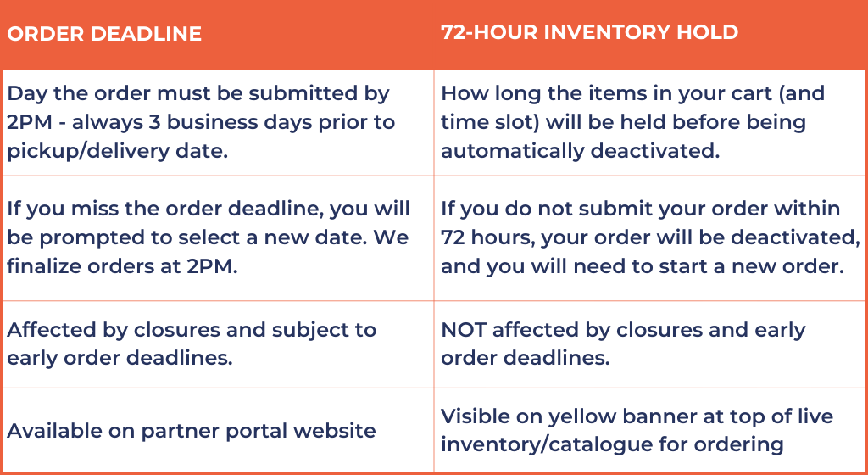
Order Deadline vs. 72-Hour Inventory Hold
You must honor whichever of these dates comes first in order to keep your order.

Slide 7
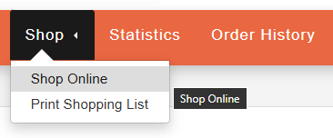
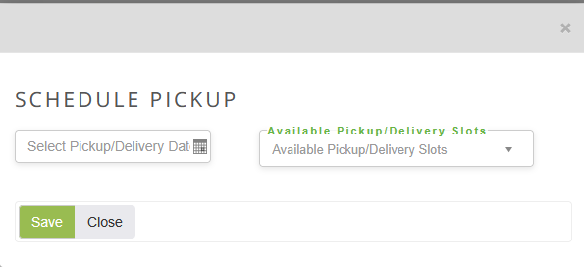
How to Order
  Click on the “Shop” tab at the top of the screen and click on “Shop Online”
  On the “Schedule Pickup” window, select your pickup/delivery date on the left side
  On the right, select the time slot
    A helpful tip to consider: Type the name of your selected location in the box. Example, for Kingston timeslots type in KINGSTON
    Please note: You will confirm pickup or delivery at a later step
    Important Reminders
    Once you start an order, your items will be held for up to 48 hours. Please be sure to check-out as soon as possible
    You may still edit your shopping cart during your 3-day window by contacting the Orders Team: (518) 786-3691 x3000

Slide 8
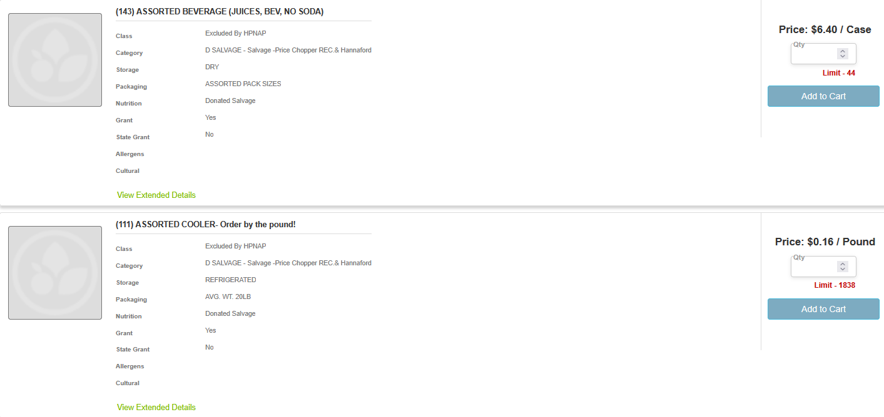
How to Order - Continued
Certain products will be charged by case or by pound, so be mindful when selecting the quantity.
If a product’s pricing is "by the pound," please check the “Packaging” field on the product
For example, if a product’s packaging says, “AVG. WT. 20LB”, then one case of the product is equal to 20 pounds. (i.e. if I want two cases, then I would type “40” in the quantity line)
Click on “Add to Cart” once you’re done with the product

Slide 9

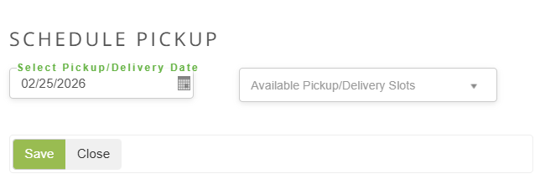
How to Change Inventory Location
When you first create your order, you don’t have the option to select the inventory location. You will first have to create a placeholder date to switch locations.
Steps:
Once you have logged onto the portal, click on the “Shop” tab and select “Shop Online” from the dropdown list.
The “Schedule Pickup” window will appear. Leave the date as is (you’ll change it to the correct one afterwards). Select any time slots and click “Save”.

Slide 10
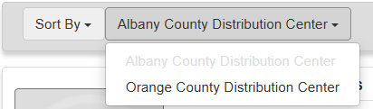
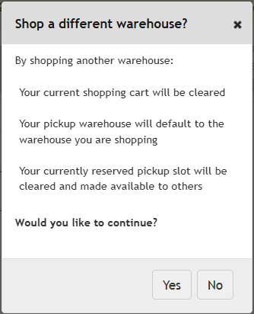
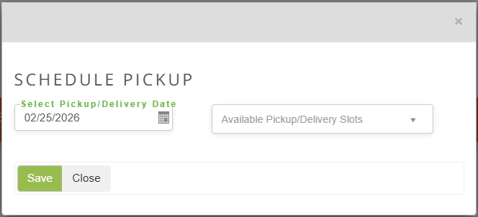
How to Change Inventory Location Cont.
Steps:
3. Once the page refreshes, head over to where it has the distribution center (it may say Albany County or Orange County).
4. Select the distribution center you want to shop from. It will then ask you to confirm if you want to switch distribution centers and you will select "Yes" if you wish to continue.
5. You will be redirected back to the “Schedule Pickup” window. From here, select your pickup/delivery date and time slot.

Slide 11
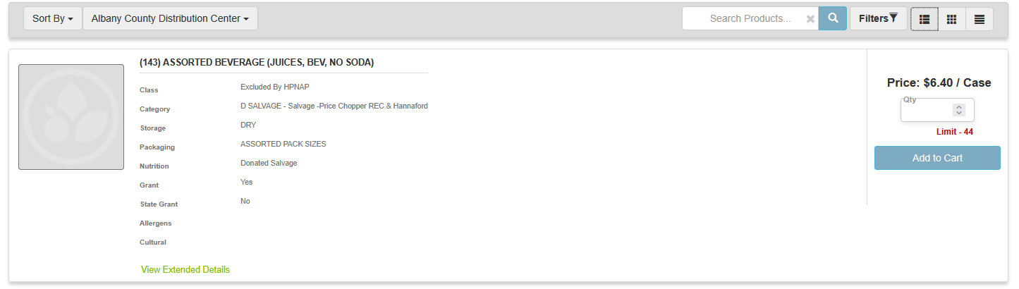
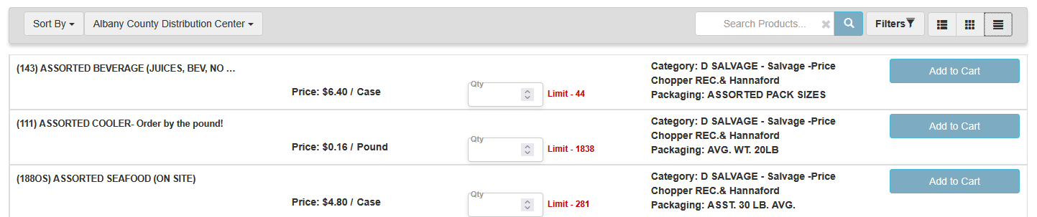
Navigating PWW
You can sort the inventory to the Albany County or Orange County by selecting the “Sort By” option.
You can search up a product by using the search bar with the magnifying glass icon
  You can type in the name of the product or the product number (i.e. Alani Energy Drinks or 86520)
  You can filter the products by clicking the “Filters” option. You can filter the products based on category, price, and a more.
  You may also select how the products are displayed by clicking one of three display icons on the far right

Slide 12
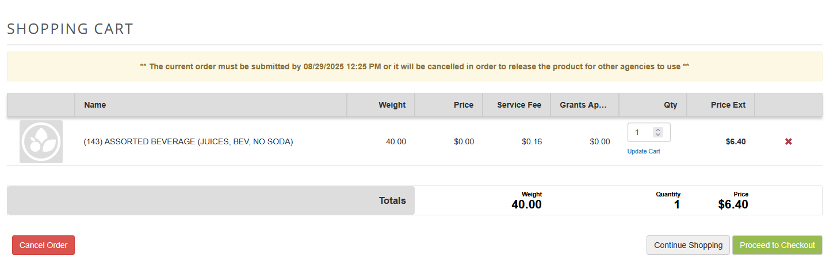
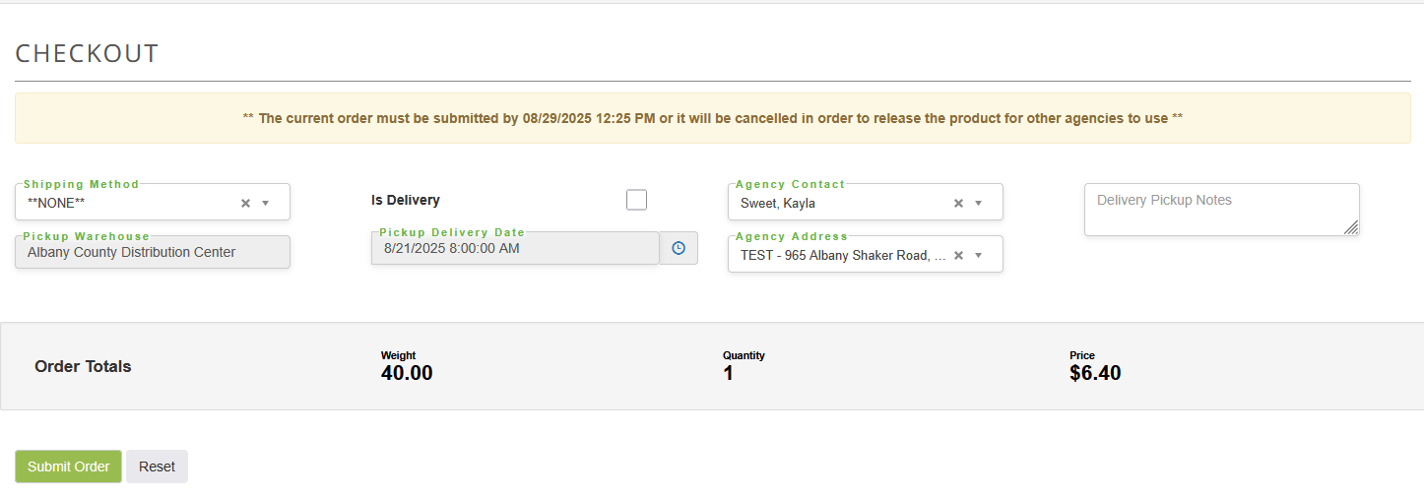
How to Checkout
Click on the shopping cart icon on the top of the website.
Click “Proceed to Checkout”.
Please include the name of the person picking up the order in the “Delivery Pickup Notes” textbox.
Please make sure to select if your order is a pickup or delivery in the “Shipping Method” dropdown list.
Click on “Submit Order” once you’re done. Please note: If you need to pick a new date, you can do so on this section.
Once your order is reviewed, you will receive a follow-up email to notify you that the order was entered correctly.

Slide 13


Questions or Concerns?
Contact us!
Please feel free to contact the Orders Team
Email Address
orders@regionalfoodbank.net
Phone
(518) 786-3691 x3000

